Slide 1
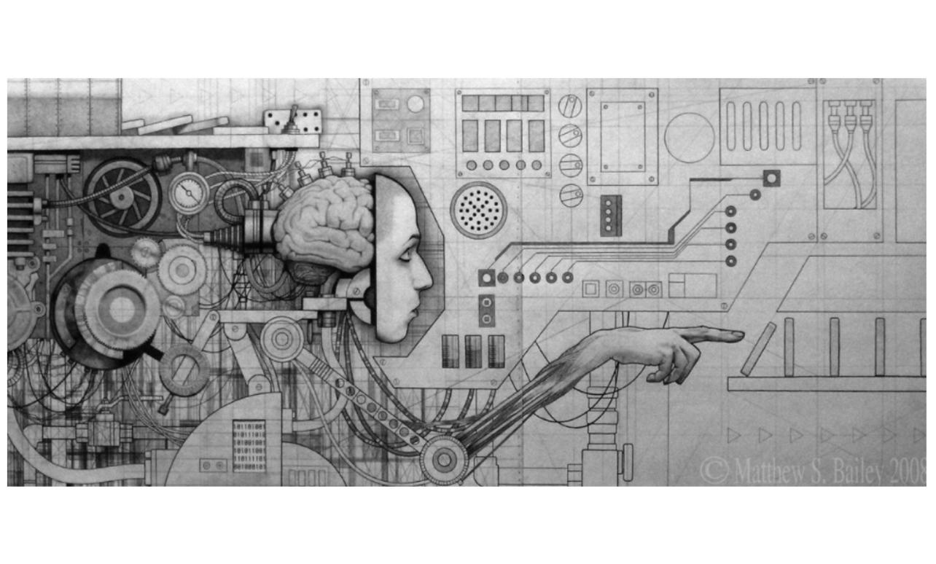

Introduction to Data Science
A Straightforward, Short, and Non - Academic Approach
By John Thomas Foxworthy
Data Scientist

Slide 2

Definitions
Relabeling
Motto
Prior Job Titles
Origin
Models and Methodologies
Most Common Mistakes
Data Science Workflow
Learning Resources
The Future

Slide 3
Definitions
What’s with all the Learning?
Data Science | The re - packaging of Statistics with more computing resources and techniques
Machine Learning (ML) | A software program that makes decisions without explicit programing
Deep Learning (DL) | Machine Learning with depth or various layers such as a Neural Network
Supervised Learning | Predictive Analytics
Semi - Supervised Learning | Both Predictive and Descriptive Analytics
Unsurprised Learning | Descriptive Analytics
Reinforcement Learning (DL) | A software agent that observes, then acts to receive rewards
Artificial Intelligence (AI) | Anything that is not biological that behaves biological

Slide 4

Definitions and their Evolution
Supervised Learning
Supervised Learning
Unsupervised Learning
Supervised Learning
*
Unsupervised Learning
Reinforcement Learning
Phase One
Phase Two
Phase Three
* Semi-Supervised Learning

Slide 5
The Current State of Definitions of Data Science
Artificial Intelligence
Machine Learning
Supervised Learning
Deep
Learning
Unsupervised Learning
Reinforcement Learning

Slide 6
Definition Breakdown with (Un)Supervised Learning
Subject Area | Unsupervised Learning | Supervised Learning
Business | Inputs | Inputs & Outputs
Engineering | Drivers | Drivers & Outcomes
Mathematics | Regressors | Regressors & Regressands
Statistics | Independent Variables | Independent Variables & Dependent Variables
Psychometrics | Predictors | Predictors & Responses
General Science | Explanatory | Explanatories & Focuses
Linguistics | Descriptive | Descriptives & Predictive
Machine Learning | Unlabeled Training Data | Unlabeled Training Data & Labeled Training Data

Slide 7
2. Relabeling Defines Data Science and its Purpose
Statistical Learning | Machine Learning
Fitting Equations | Learning Process
Model | Model (ML) or Network (DL) or No Model (RL)
Regression or Classification | Supervised Learning (Predictive Analytics)
Density Estimation or Clustering | Unsupervised Learning (Descriptive Analytics)
THEORY
APPLIED

Slide 8
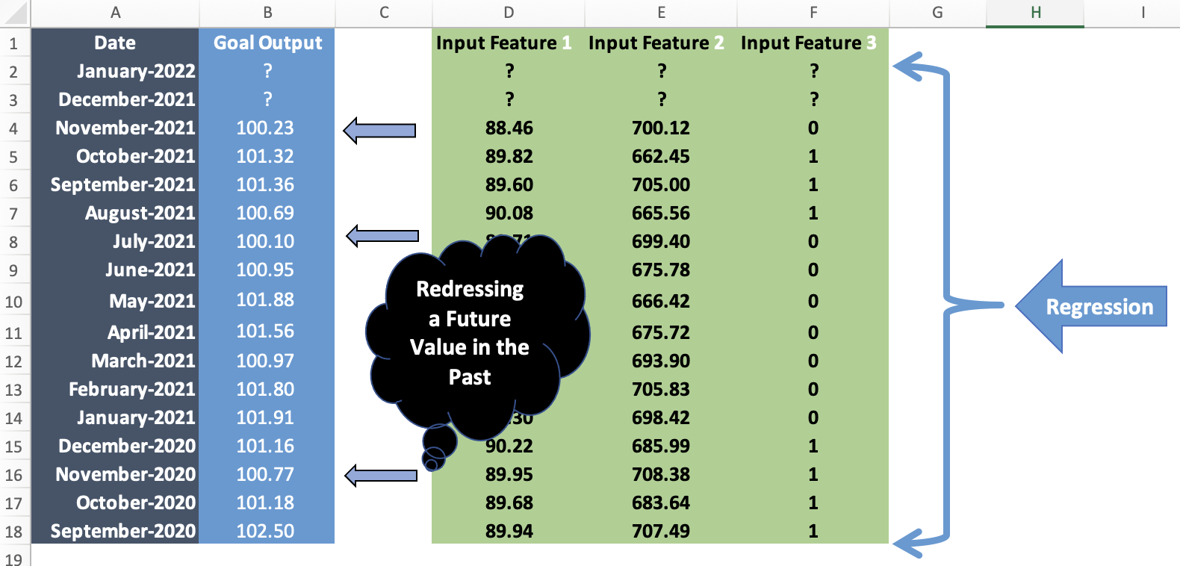
2. What is a Regression Model? A Clarification
BACK TO THE FUTURE

Slide 9
3. Data Science Motto
All models are wrong,
but some are useful.
George Box (1976)

Slide 10
4. Prior Job Titles of Today’s Data Scientist
Statistician
Psychometrician
(Clinical Psychologist)
Operation Researcher
Computational Linguist
(Language Scientist)
Computer Scientist
Econometrician (Statistical Economist)
Image Processing Engineer

Slide 11

5. Where did Data Science come from?
William S. Cleveland
Professor of Statistics at Purdue University, Indiana
Vote at the Statistical Symposium with various University Professors in 2001
Processing power of computers increasing exponentially
Exponential growth of the quantity and quality of data, esp unstructured

Slide 12
Question
If you clone a human being, then
does the clone have artificial intelligence?

Slide 13
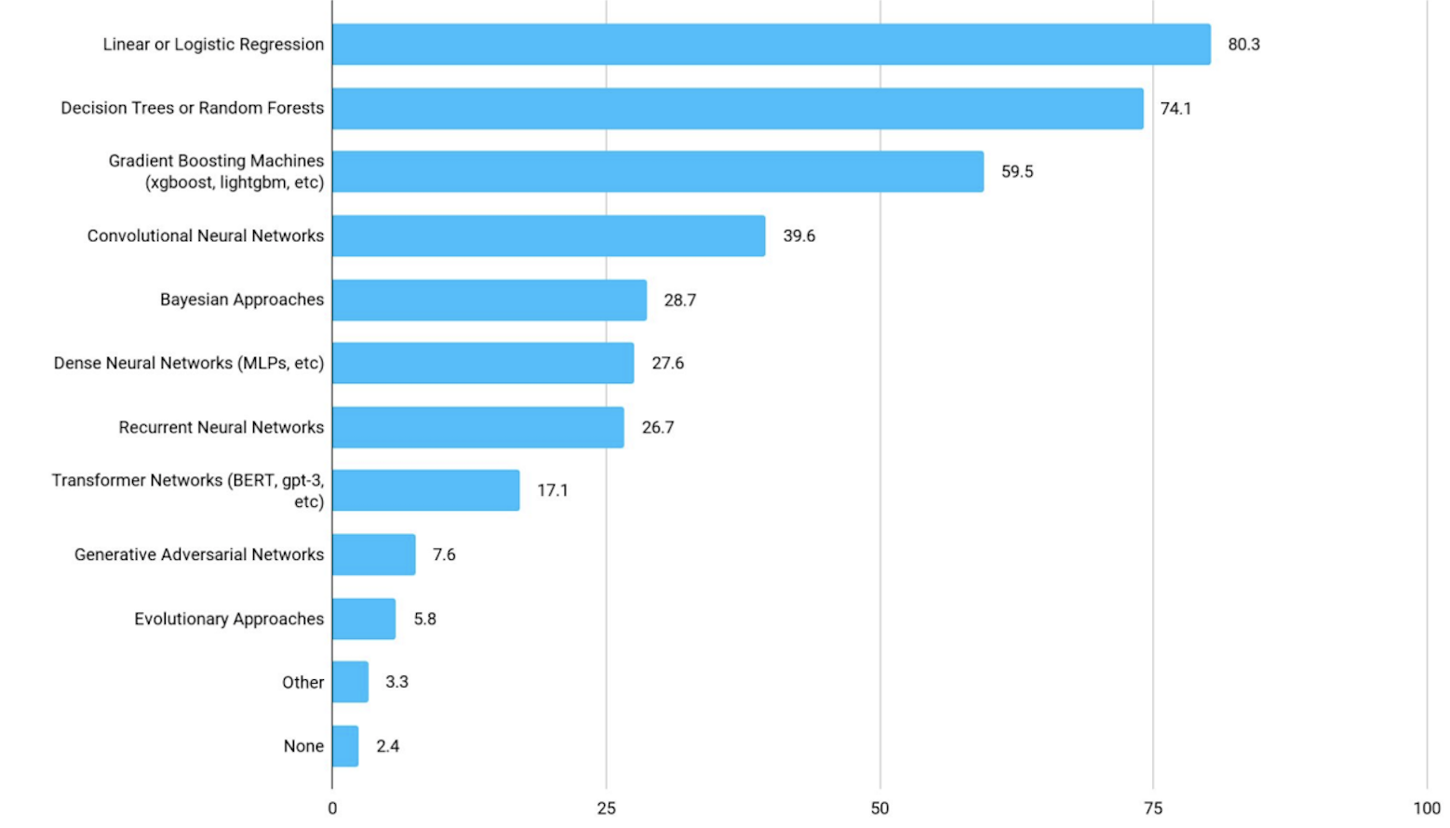
6. What Prediction Models have you placed in Production?

Slide 14
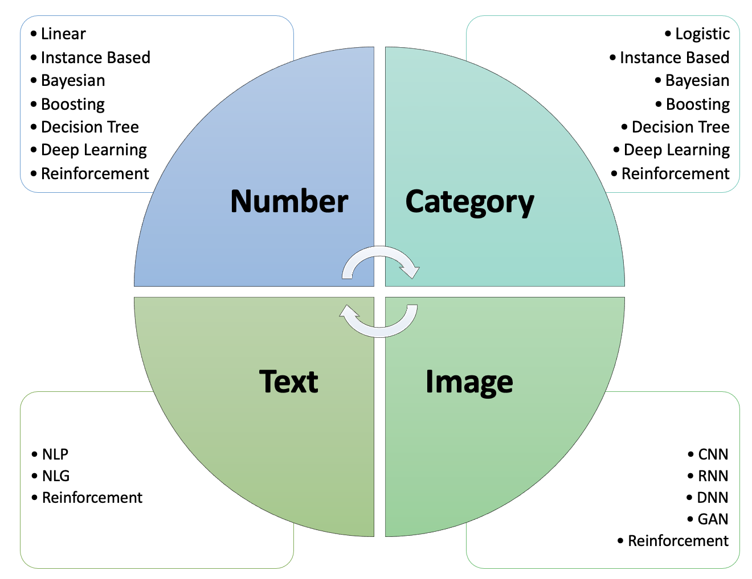
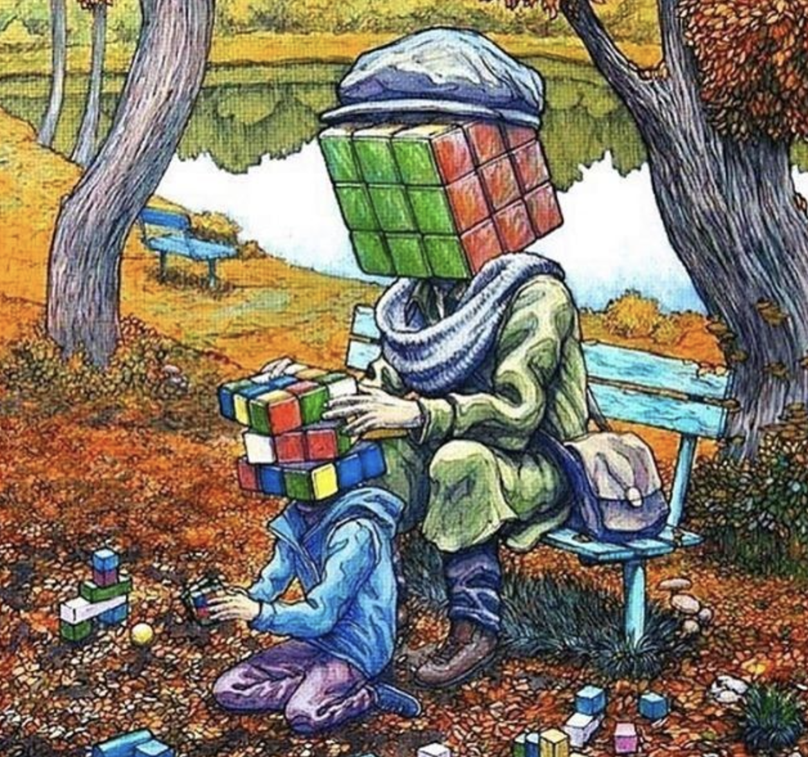
6. Supervised Learning and Predictive Analytics

Slide 15
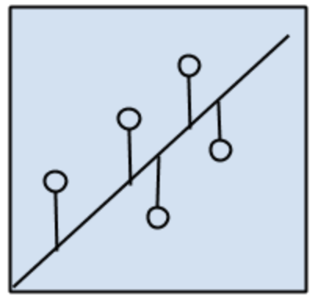
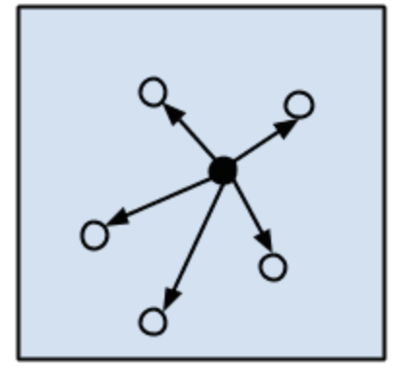
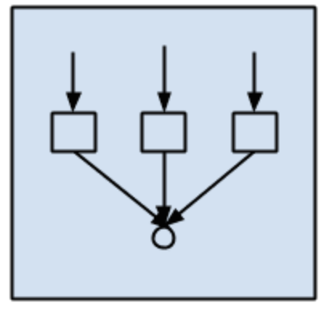
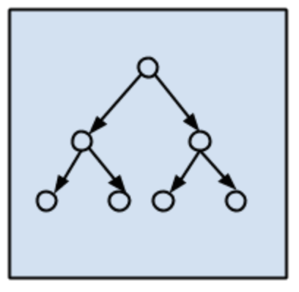
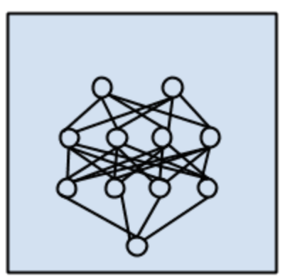
6. The Three Major Methodologies for Prediction
A
B
C
D
Regression
Instance - Based
Ensemble
Decision Tree
Static and Sequential
Data
Model
Output
Iterative or Flow Chart
Data
Model
Output, back to (2)
E
Deep Learning
Neural Network as a Set of Models

Slide 16
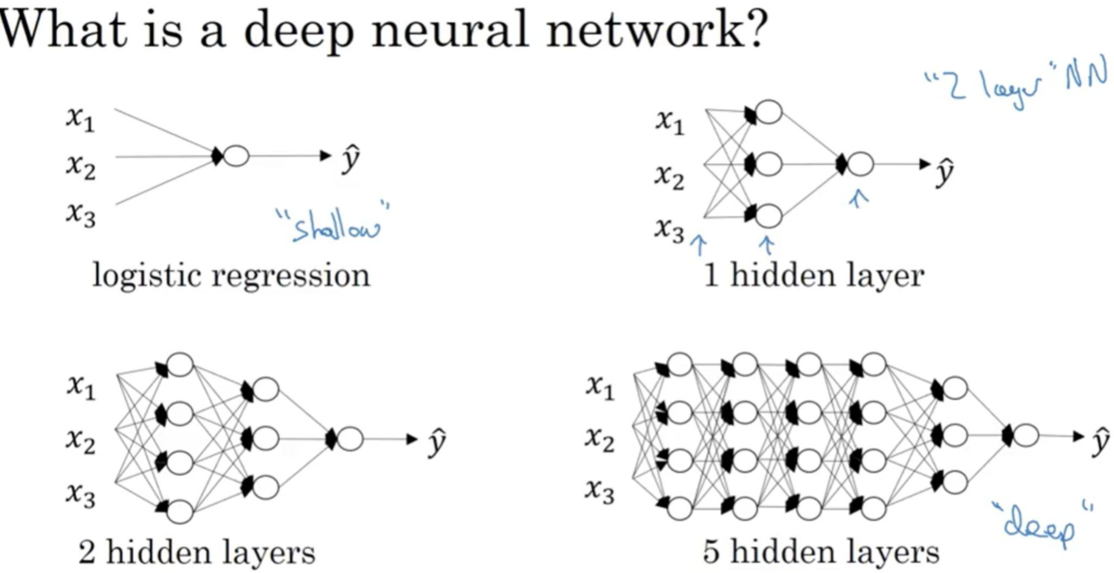
6. Deep Learning Method for Artificial Intelligence

Slide 17
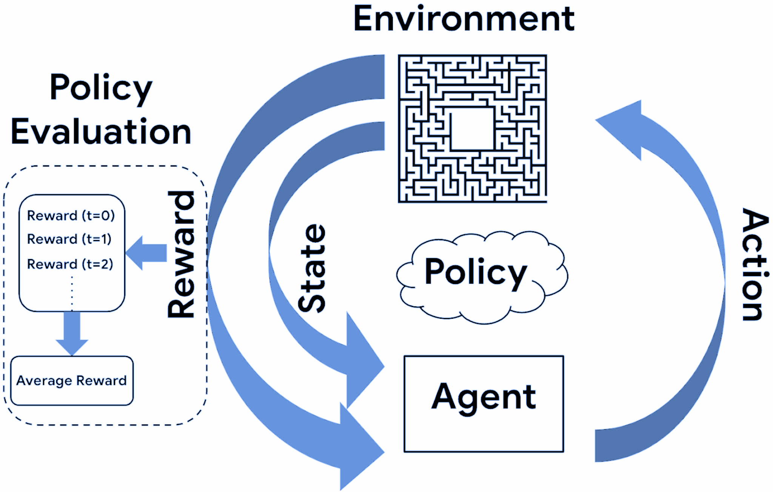
6. Reinforcement Learning
Method for
Artificial
Intelligence
Grok
Grokking

Slide 18
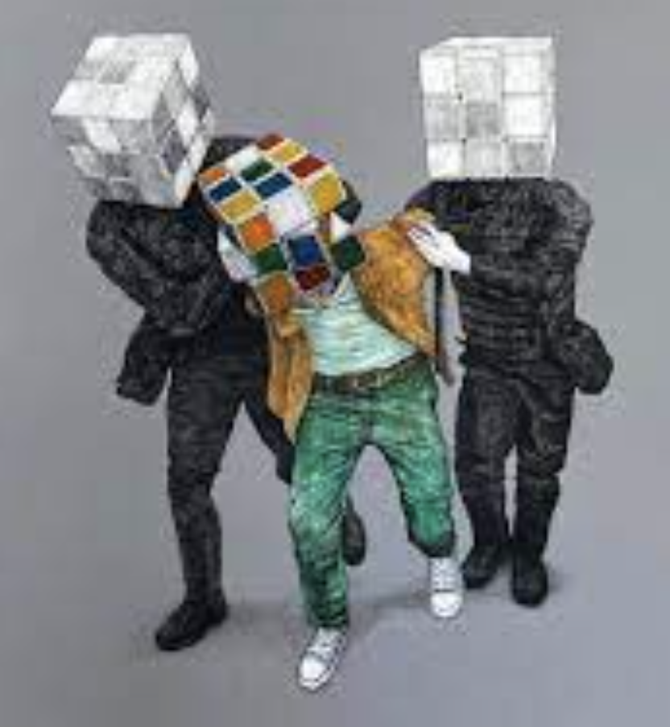
6. Unsupervised Learning and Descriptive Analytics
Clustering
Feature Selection Automation
Data Reduction Techniques
Autoencoder
Anomaly Detection
Group Segmentation
Should you ask your Supervisor about Unsupervised Learning? Yes!

Slide 19
7. Data Science Prediction Mistakes
Always Inaccurate
Reselect Features
Change Model
Confusing Cause and Effect
Endogeneity
The Old Way does not work anymore
Regime Switching
Too Many Similar Features
Multicollinearity or try DL
Same Model, Different Results
High Variance
Overgeneralizing
Overfitting
Missing Data causes
No Prediction
Wrong Model
More Data, Less Usefulness
High Bias
Misclassification
Type I, False Positive

Slide 20
8. Generalized Data Science Workflow
(1) Business Understanding
(2) Data Understanding
Cross Industry
Standard Process
For Data Mining
(CRISP - DM)
(6) Deployment
(3) Data Preparation
(5) Evaluation
(4) Modeling

Slide 21
9. Data Science Learning Resources
Most Popular Course in the World for Data Science
Professor Andrew Ng, Stanford University
https://www.coursera.org/learn/machine-learning
Effective Data Analytics
Cole Nussbaumer Knaflic, Former People Analytics Team Manager at Google
https://www.storytellingwithdata.com

Slide 22

10. The Future
Boosting will overtake Linear and Logistic Regression
Reinforcement Learning Software Agents will overtake ML
Neural Networks will expand as data grows exponentially
Just about everything in our lives will be Artificial Intelligence
ANY QUESTIONS?

